Slide 1
UNIVERSITY MANAGEMENT SYSTEM
Submitted in the partial fulfillment for the award of the degree of
BACHELOR OF ENGINEERING
IN
Artificial Intelligence Machine Learning
Submitted by:
Ankit Rao (20BCS6862)
Ishita Tiwari (20BCS6859)
Under the Supervision of:
MS. Monika
Department of AIT-CSE
DISCOVER . LEARN . EMPOWER

Slide 2
Outline
Introduction to Project
Problem Formulation
Objectives of the work
Methodology used
Results and Outputs
Conclusion
Future Scope
References

Slide 3
Introduction to Project
The main goal of the project is to obtain the complete and correct information. Because University management department of an organization maintains a record of
The Faculty and The Students.
In University a large amount of data is processed and the results are used in running an organization. The University management system project maintains the list of colleges and their different streams. It also maintains the delete and the recycle department with a proper menu system.
The purpose of this program is to develop the management control system in university

Slide 4
Problem Formulation
Keeping track the all activities and their record on paper and error. It is also very efficient and a time-consuming process of observing continuous increase in number of clients visiting the University. Recording and maintaining all the record highly unreliable, inefficient and error pron.
The problem facing the current manual system is difficult to update and maintain, inconsistent data, insecurity, difficult to impose different various data files and difficult to data backup. It is against this backdrop that automated system is being developed to addressed the problem.
A good university management system will process input data faster and reduce clerical time, while:
Assuring management control in making certain that output is correct.
Generally useful reports at little or no incremental cost.
Project is handled with oops concept.

Slide 5
Objectives
My project “UNIVERSITY MANAGEMNT SYSTEM” maintains detailed records of all the Colleges and Students as well as and the Examination and the Result department.
The University data file should contain following information:
Details of College information
In this section the project keeps the record of college id, college name, college location, college running the stream and the degree the college is running and maintains the information in college.dat data.
Details of Student formation
In this section the project keeps the record of student id, student name, student address, father’s name, contact number, degree stream, std code.

Slide 6
Methodology used
Our project is meted out during a much-managed way. For that we do our coding in an exceedingly few easy step which is understandable by almost everyone. its easy to grasp and use. Our project initial step was to gather related data from the user. Then after collection of data they're analyzed. We are going to add different functions to perform different functions.
We are well aware about the fact that C++ follows bottom-up approach which is clearly depicted in our code. As a matter of fact, that compilation begins with main function our console will first encounter main function where function named as login system is present.
When the console moves to the login system function there will we three options provided to the user i.e., to register, to login and forgot password if the user forgets about the credentials the details that he/she want to enter and after going through the login system function the console name to main function where it will encounter the do-while loop which will provide a user eight options to perform different task.

Slide 7
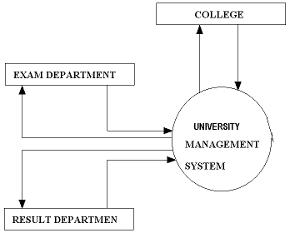
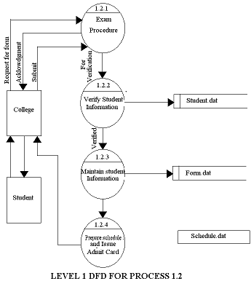
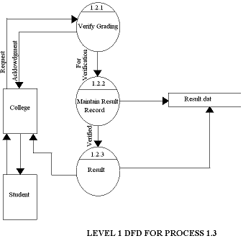
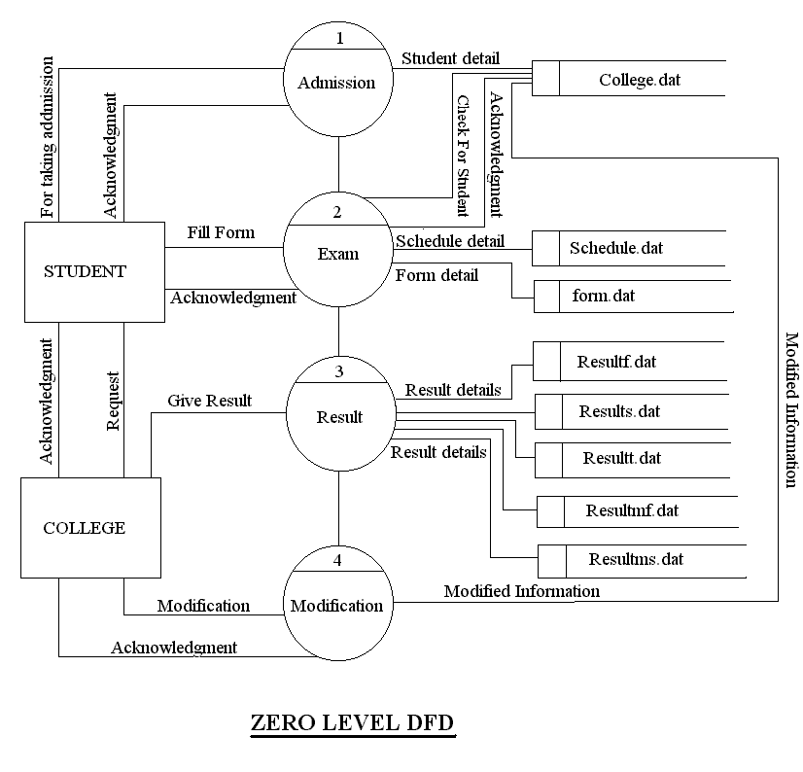
Data flow Diagram

Slide 8
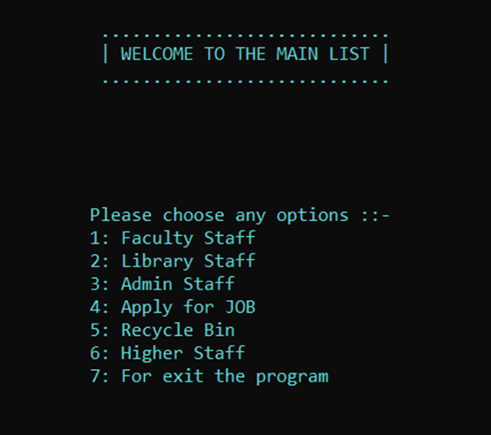
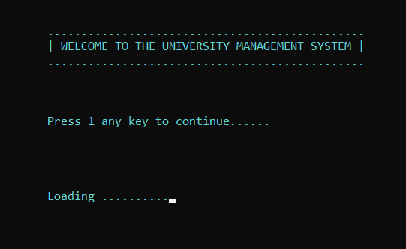
Results and Outputs
Welcome Screen

Slide 9
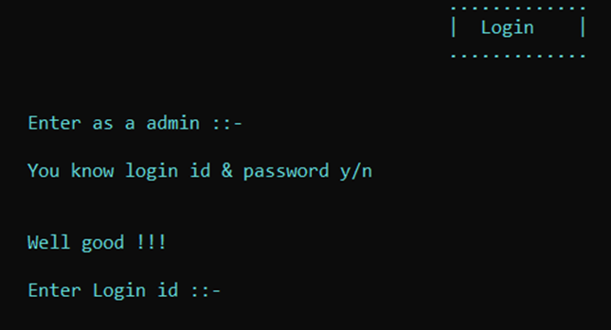
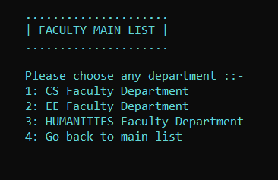
1. Faculty Staff
Log In Page

Slide 10
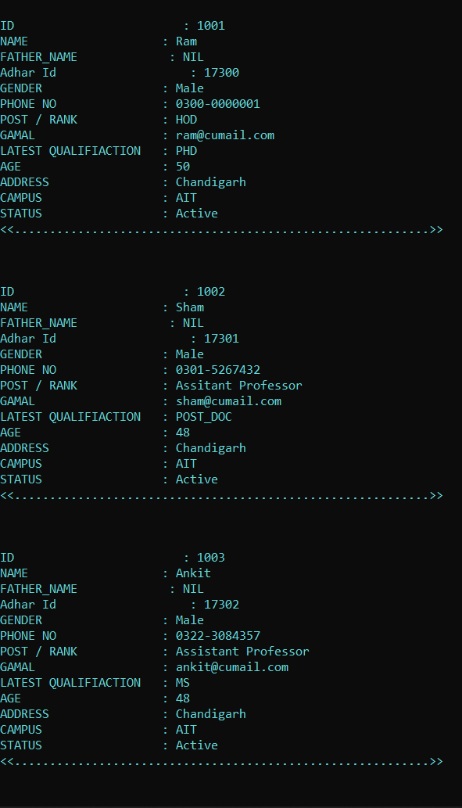
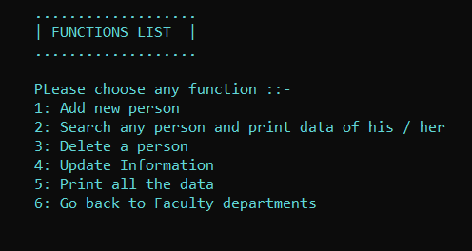

Faculty Staff → 1. CS Faculty Department
Print all the data
Add new person

Slide 11
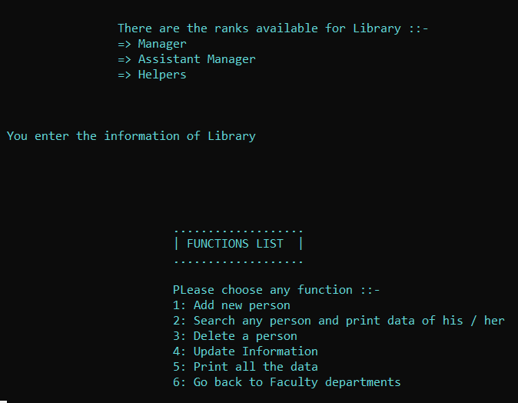
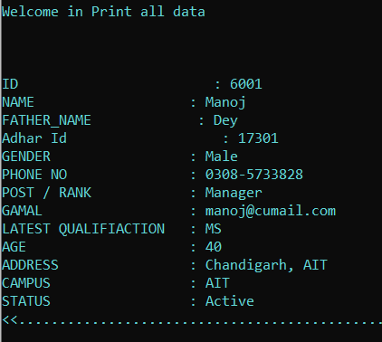
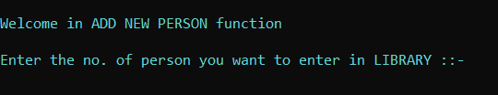
2. Library Staff
5. Print all data
1. Add new Person

Slide 12
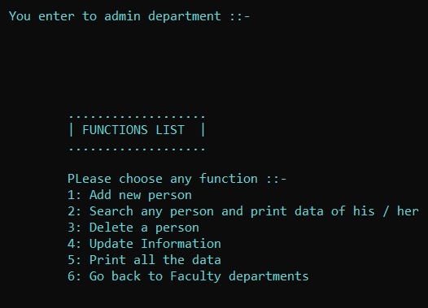
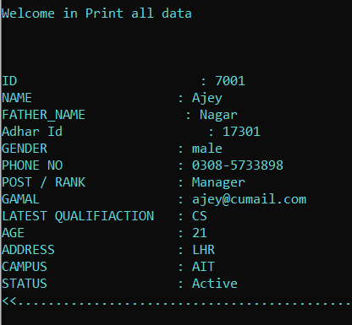


3. Admin
5. Print all the data
1. Add new person

Slide 13
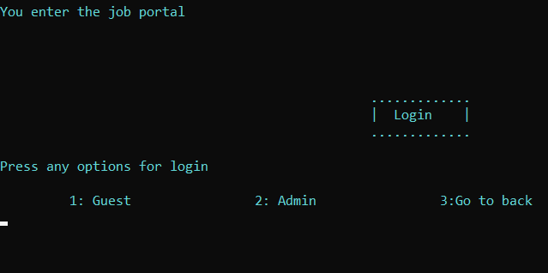

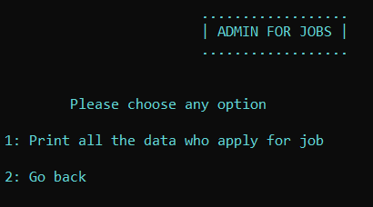
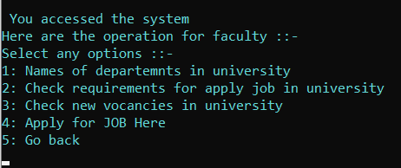
4. Apply For Job
2. Admin
1. Guest

Slide 14
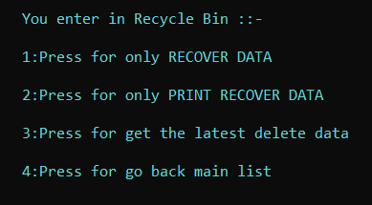

5. Recycle Bin
1. Press for Only Recover Data

Slide 15
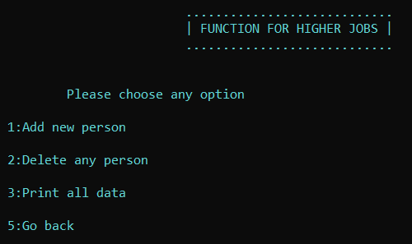
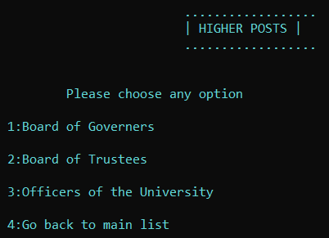
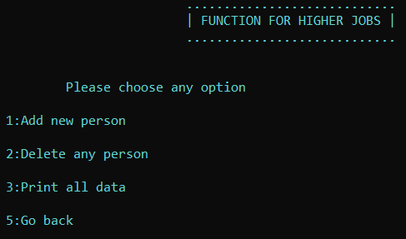
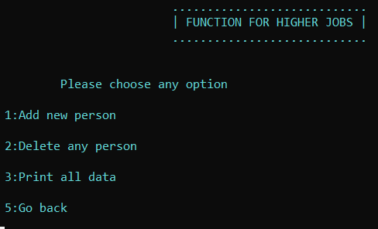
6. Higher Post
1. Board Of Governors
2. Board Of Trustees
3. Officers of the University

Slide 16
Conclusion
The aim of the proposed system is to develop a system of improved facilities. The proposed system can overcome all the limitations of the
existing system. The system provides proper security and reduces the manual work.
Security of data.
Ensure data accuracies.
Proper control of the higher officials.
Minimize manual data entry.
Minimum time needed for various processing.
Greater efficiency.
Better service.
User friendliness and interactive.

Slide 17
Future Scope
This overall project is basically written in function and can be used in conjunction with other program, for future development for UNIVERSITY system.
We have provided many data function through which any one can know about any STUDENT/COLLEGE giving COLLEGE/STUDENT number.
The project is using the modern trend OOPs that gives a better design to the software, which help in maintaining code in terms of reusability, modifiability, etc. These attributes a quit wanting in today’s complex software scenario. OOPs giving a better designs objective taken this problem and provide better design objective.
This software is design with OOPs so we chosen C++ language, which provide all features which will be needed in future. This software is having sounding economic aspect with the motion of controlling the local market.
Cost of our project is comparatively low.

Slide 18
References
https://www.codewithc.com/university-management-system-project-c/
https://www.scribd.com/document/136451209/University-Course-Details-Management-System-in-c
https://code-projects.org/simple-college-management-system-in-c-with-source-code/
http://codefervor.blogspot.com/2015/02/university-management-system-project.html
https://1000projects.org/university-management-system-cpp-project.html
https://1000projects.org/university-management-system-project-c-source-code.html
https://www.scribd.com/document/136451209/University-Course-Details-Management-System-in-c

